Slide 1
CS5112: Algorithms and Data Structures for Applications
Dijkstra’s algorithm
Ramin Zabih
Some slides from: K. Wayne

Slide 2
Administrivia
Web site is: https://github.com/cornelltech/CS5112-F19
As usual, this is pretty much all you need to know
Will be updated with lectures and other announcements
Also contains CMS link for student grades
Quiz #1 will be out Thursday, due in 24 hours
Multiple choice, on the honor system
We drop your lowest quiz, these are mostly to help you keep up

Slide 3
Lecture Outline
The shortest path problem
Dijkstra’s algorithm
Applications: image editing and pirate grammar
Bonus application: modeling a CS5112 student

Slide 4
Two very common approaches in CS
Given a problem where you are searching for a solution:
Try everything (exhaustive search)
Do what seems best at the moment, repeatedly (greedy algorithms)
Exhaustive search (almost) never works on serious problems
Greedy algorithms are widely used
Currently famous example: SGD for neural networks
Note: there are other approaches
Such as smart exhaustive search, e.g. dynamic programming

Slide 5

The shortest path problem
General version: given a graph with edge weights, a starting node $s$ and a target $t$, find shortest path from $s$to $t$
Claim: this problem is impossible to solve!

Slide 6
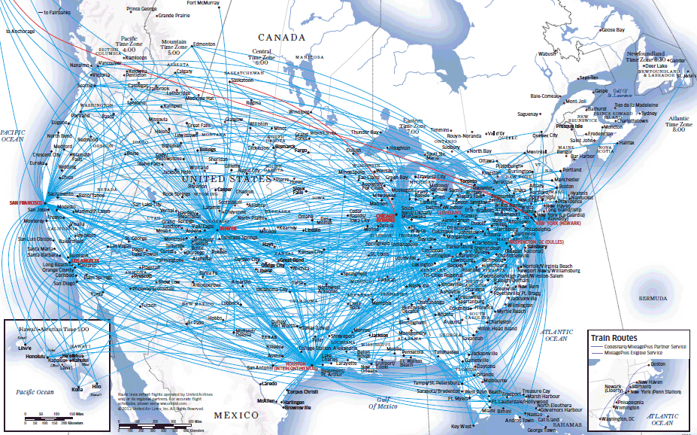
Obvious application of shortest paths: airfare
Nodes are cities, edges are direct flights, weights are airfare
What is the cheapest way to get from LGA to Ithaca?
Presumably you can charter a plane

Slide 7
Fixing the problem definition
Suppose that there is a flight from Boise to El Paso, and back again, that the airline pays you $1 to fly around
Further, suppose that you can get to Boise (or El Paso)
You can make an arbitrary amount of money by just flying back and forth!
This is a cycle in the graph whose sum of weights is negative
Easy solution: require positive edge weights
Or maybe detect negative cycles?

Slide 8
Not so obvious applications
Making fake photographs
Speech recognition/predicting stock prices by DTW
Pirate grammar!
Modeling a student (at end of class)

Slide 9

Making fake photographs
How do we create images like this:
Given an image, how do you cut out an object from it?
You don’t want to manually select the pixels

Slide 10
Intelligent scissors
Idea: shortest paths
E.N. Mortensen and W.A. Barrett, Interactive Segmentation with Intelligent Scissors, SIGGRAPH 1995
Adobe calls this the “Magnetic Lasso”
Video here

Slide 11
Dynamic Time Warping (DTW)

Slide 12
Rules of Pirate grammar
Pirates always start their sentences with “Barkeep!”
90% of the time they next say “More” (i.e., they order)
10% of the time they next say “Yer a” (i.e., they insult)
If they say “More”, they next say:
60% “Of your best”
40% “Of the same”
Lots more rules, discovered by experts in pirate linguistics
Question: what sentence is a pirate most likely to say?

Slide 13
Pirate grammar as a graph
“Barkeep!”
.9
“More”
.6
“of your best”
“grog!”
.1
.4
“Yer a”
“of the same”
“wimpy”
“grub.”
“scurvy”
“chicken.”

Slide 14
Simplified pirate grammar
“Barkeep!”
.9
“More”
.6
“of your best grog!”
.1
.4
“Yer a”
“of the same wimpy grub.”
“scurvy chicken.”
1

Slide 15
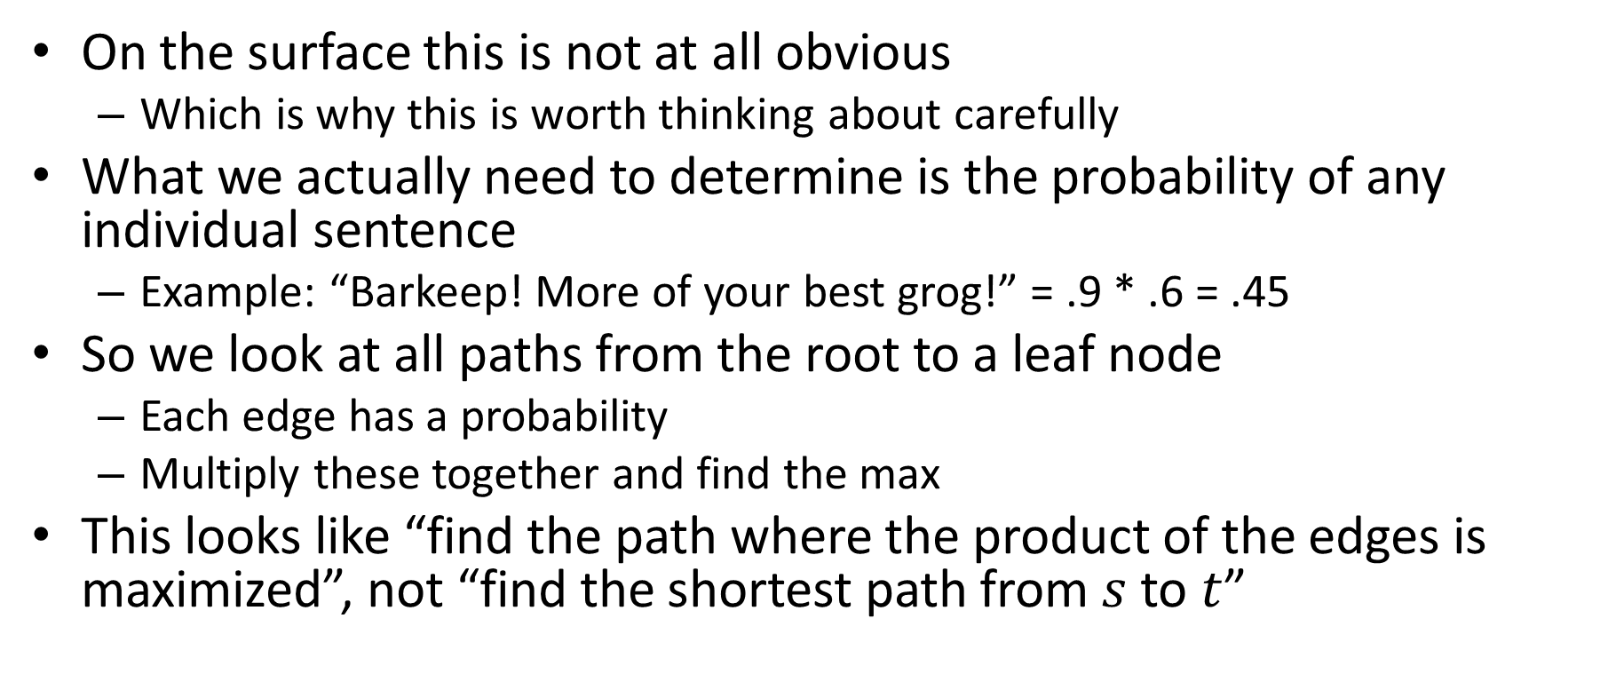
How to make this into shortest paths?
On the surface this is not at all obvious
Which is why this is worth thinking about carefully
What we actually need to determine is the probability of any individual sentence
Example: “Barkeep! More of your best grog!” = .9 * .6 = .45
So we look at all paths from the root to a leaf node
Each edge has a probability
Multiply these together and find the max
This looks like “find the path where the product of the edges is maximized”, not “find the shortest path from $s$ to $t$”

Slide 16

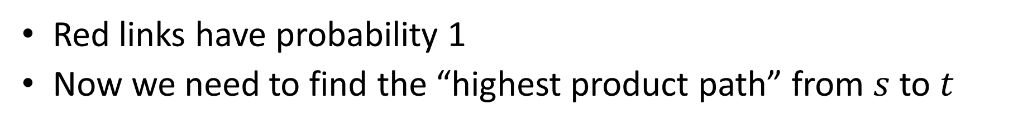

Easy part: Add a fake source and sink
“Barkeep!”
.9
“More”
.6
“of your best grog!”
$$s$$
$$t$$
.1
.4
“Yer a”
“of the same wimpy grub.”
“scurvy chicken.”
1
Red links have probability 1
Now we need to find the “highest product path” from $s$ to $t$

Slide 17
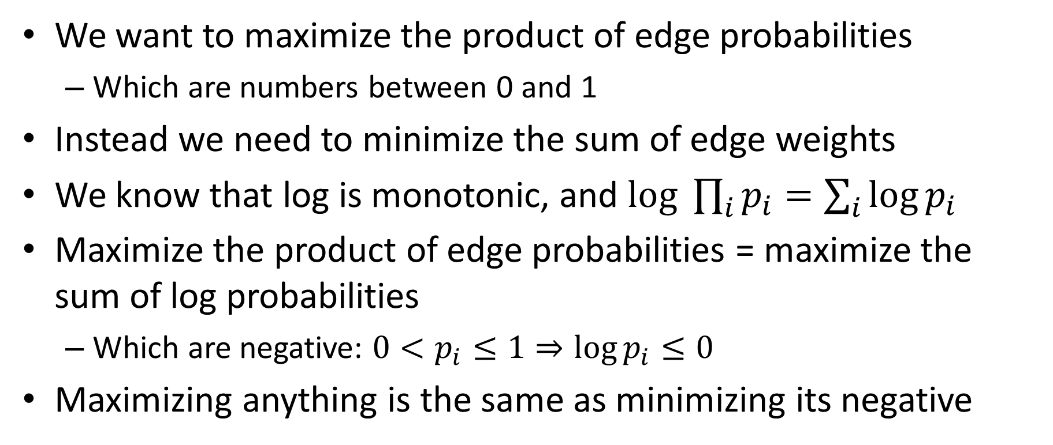
Algebra to the rescue
We want to maximize the product of edge probabilities
Which are numbers between 0 and 1
Instead we need to minimize the sum of edge weights
We know that log is monotonic, and $log \prod_{i}{p_{i}=\sum_{i}{\log{p_{i}}}}$
Maximize the product of edge probabilities = maximize the sum of log probabilities
Which are negative: $0<p_{i}≤1⇒\log{p_{i}≤0}$
Maximizing anything is the same as minimizing its negative

Slide 18
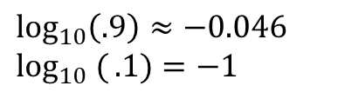
Algebra in action
“Barkeep!”
.9
“More”
.6
“of your best grog!”
$$s$$
$$t$$
.1
.4
“Yer a”
“of the same wimpy grub.”
“scurvy chicken.”
1
$$\log_{10}\left(.9\right)≈−0.046$$
$$\log_{10} ({.1)=−1}$$

Slide 19
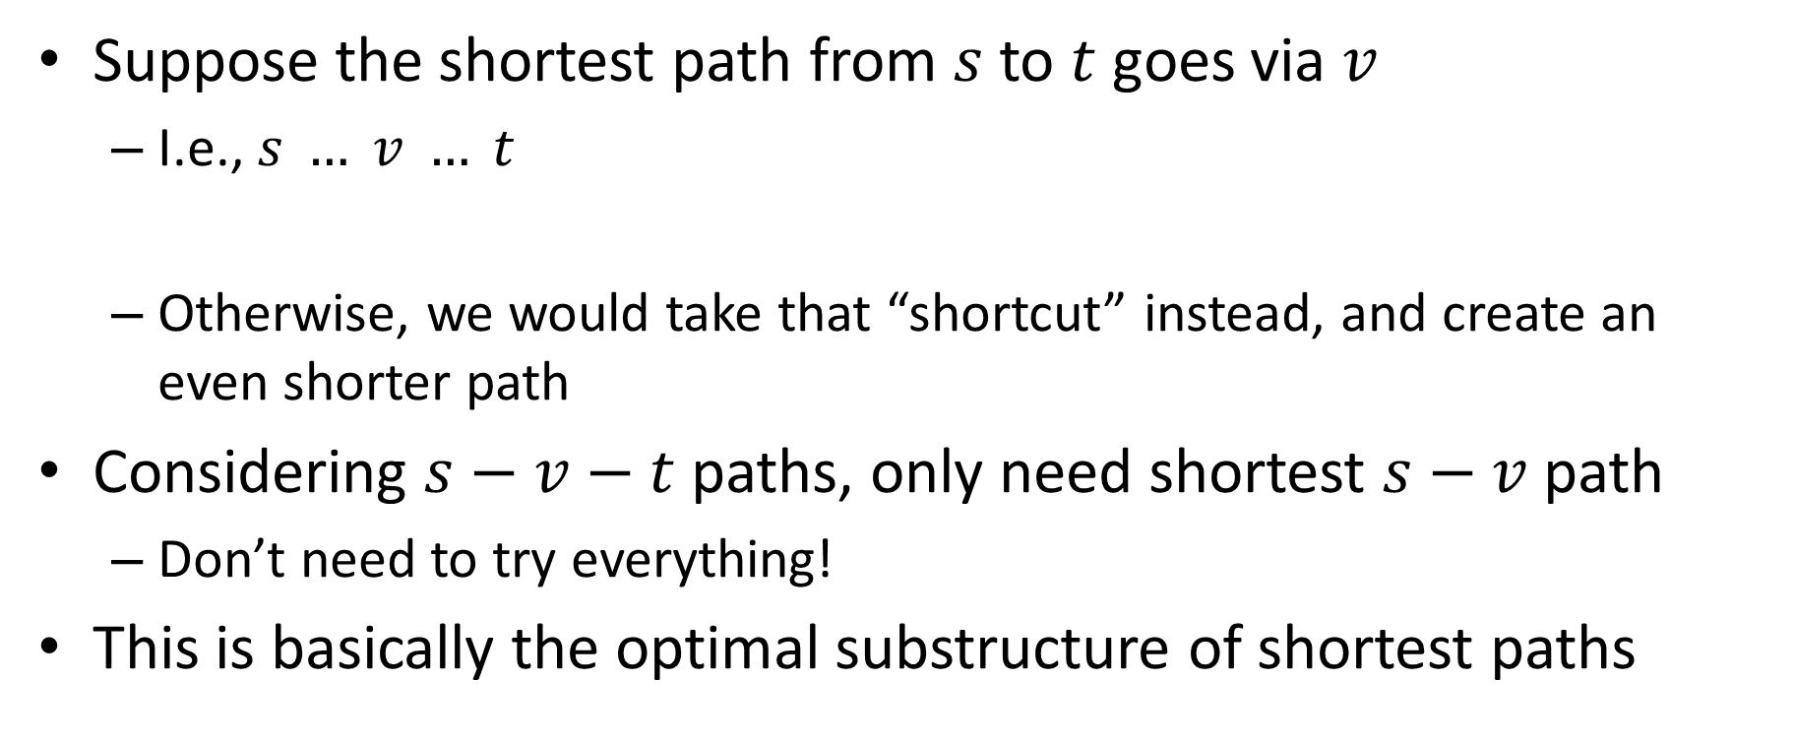
Key property of shortest paths
Suppose the shortest path from $s$ to $t$goes via $v$
I.e., $s … v … t$
Otherwise, we would take that “shortcut” instead, and create an even shorter path
Considering $s−v−t$ paths, only need shortest $s−v$path
Don’t need to try everything!
This is basically the optimal substructure of shortest paths
shortest s-v path

Slide 20
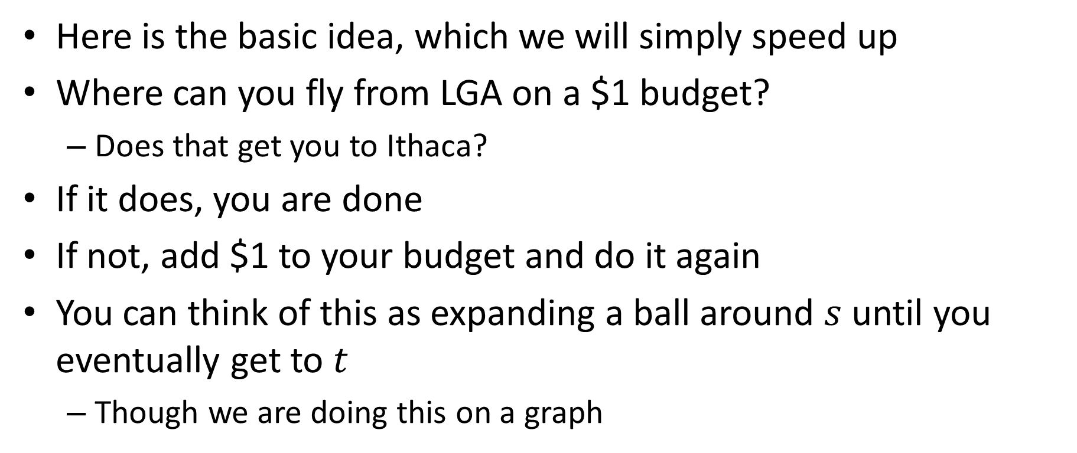
Shortest paths by increasing budgets
Here is the basic idea, which we will simply speed up
Where can you fly from LGA on a $1 budget?
Does that get you to Ithaca?
If it does, you are done
If not, add $1 to your budget and do it again
You can think of this as expanding a ball around $s$ until you eventually get to $t$
Though we are doing this on a graph

Slide 21







Example
For $1 can get to $u$
For $2 can also get to $v$
Gray area shows budget at $2
At $3 we can also get to $x$via $u$
Key concepts:
Explored nodes: $\{s,u,v\}$
Fringe: $\{x,y,z\}$
$$y$$
3
$$u$$
1
1
2
$$s$$
4
$$x$$
2
2
$$v$$
2
3
$$z$$

Slide 22
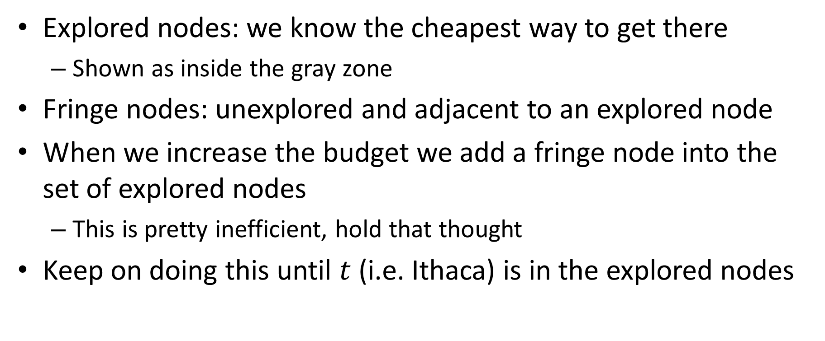
Key concepts
Explored nodes: we know the cheapest way to get there
Shown as inside the gray zone
Fringe nodes: unexplored and adjacent to an explored node
When we increase the budget we add a fringe node into the set of explored nodes
This is pretty inefficient, hold that thought
Keep on doing this until $t$ (i.e. Ithaca) is in the explored nodes

Slide 23
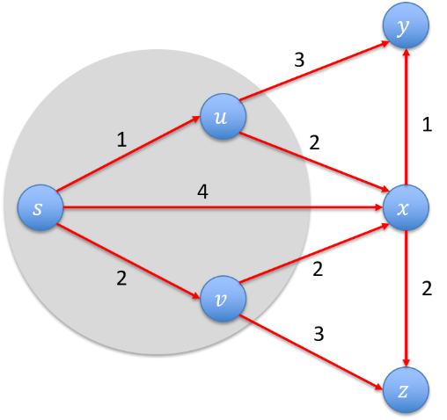
Budget approach is crazy
Suppose the cheapest flight from LGA is $500
In our example, imagine increasing by $.01
So we consider $2.01, $2.02, …
But we know that nothing will happen until we increase our budget to $3
Why not just do this directly?

Slide 24
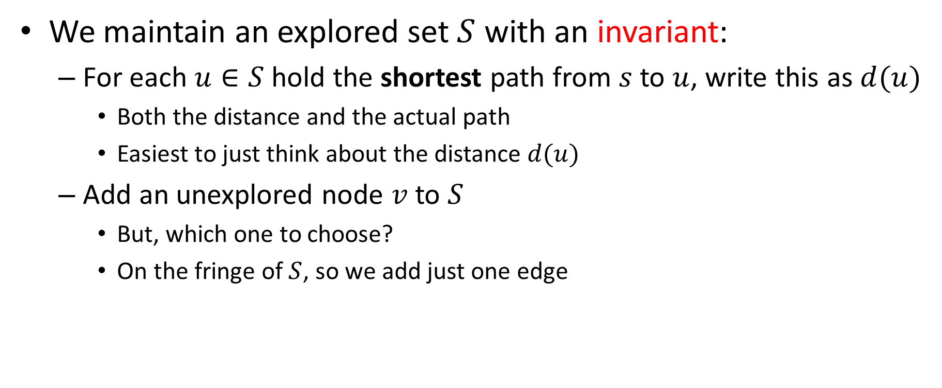
Dijkstra’s algorithm
We maintain an explored set $S$ with an invariant:
For each $u∈S$hold the shortest path from $s$ to $u$, write this as $d(u)$
Both the distance and the actual path
Easiest to just think about the distance $d(u)$
Add an unexplored node $v$to $S$
But, which one to choose?
On the fringe of $S$, so we add just one edge

Slide 25

Choice of edge for a fringe node
The fringe node $v$ can be adjacent to several nodes in $S$
If we choose to add $v$, pick the right node in $S$to connect it to
w₁
v
d(u1)
d(u1) + w₁
versus
d(u2) + w₂
u1
w₂
S
s
u2
d(u2)

Slide 26
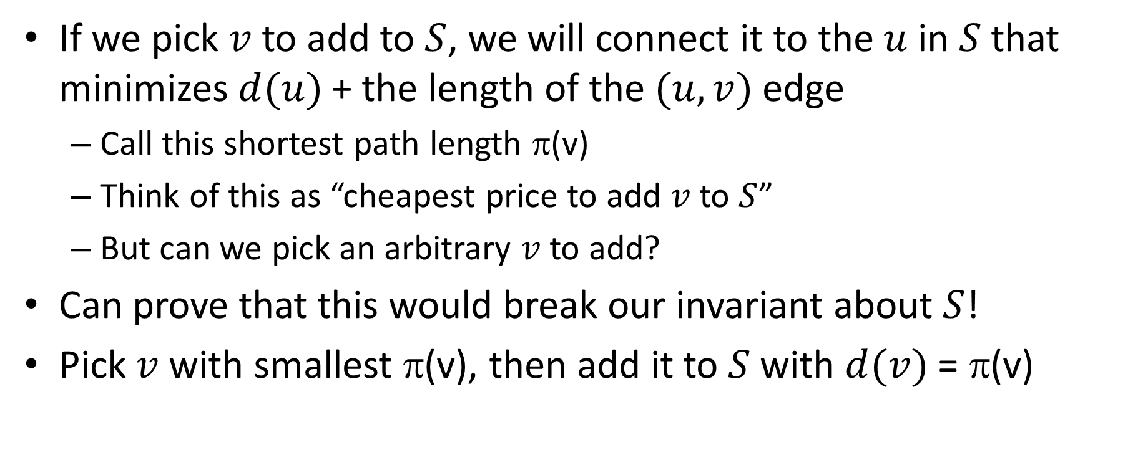
Choice of fringe node
If we pick $v$ to add to $S$, we will connect it to the $u$ in $S$that minimizes $d(u)$+ the length of the $(u,v)$ edge
Call this shortest path length π(v)
Think of this as “cheapest price to add $v$ to $S$”
But can we pick an arbitrary $v$ to add?
Can prove that this would break our invariant about $S$!
Pick $v$with smallest π(v), then add it to $S$with $d(v)$ = π(v)

Slide 27
Shortest path example
2
23
3
9
s
18
Cost of path s-2-3-5-t = 9 + 23 + 2 + 16 = 48.
14
2
6
6
30
4
19
15
5
11
5
6
20
16
7
t
44

Slide 28
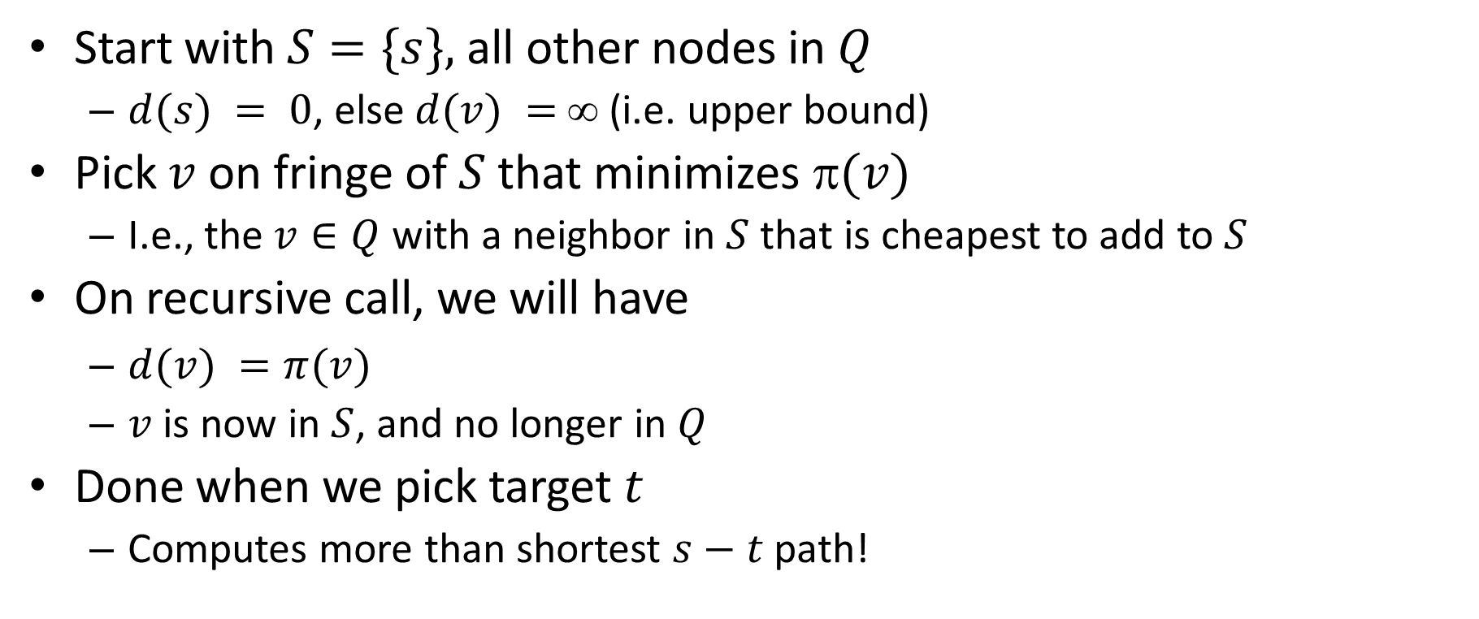
Dijkstra’s algorithm
Start with $S=\{s\},$all other nodes in $Q$
$d(s) = 0$, else $d(v) =$∞ (i.e. upper bound)
Pick $v$on fringe of $S$that minimizes $(v)$
I.e., the $v∈Q$ with a neighbor in $S$that is cheapest to add to $S$
On recursive call, we will have
$d(v) =π(v)$
$v$ is now in $S$, and no longer in $Q$
Done when we pick target $t$
Computes more than shortest $s−t$path!

Slide 29
Dijkstra's Shortest Path Algorithm
Find shortest path from s to t.
Blue edges: shortest path to a node within S.
Green edges: what we would add for each fringe vertex.
2
24
3
9
s
18
14
2
6
6
30
4
19
5
11
15
5
6
20
16
7
t
44

Slide 30
S = { s }
Q = { 2, 3, 4, 5, 6, 7, t }
∞
∞
2
24
3
0
9
s
∞
18
14
6
6
2
∞
30
∞
4
19
11
15
5
5
6
20
16
7
t
44
∞
∞

Slide 31
S = { s }
Q = { 2, 3, 4, 5, 6, 7, t }
π(2)
∞
∞
9
X
2
24
3
0
9
s
∞
14
18
14
X
6
6
2
∞
30
∞
4
19
11
15
5
5
6
20
16
7
t
44
π(7)
∞
15
∞
X

Slide 32
S = { s }
Q = { 2, 3, 4, 5, 6, 7, t }
min
∞
∞
9
X
2
24
3
0
9
s
∞
14
18
14
X
6
6
2
∞
30
∞
4
19
11
15
5
5
6
20
16
7
t
44
∞
15
∞
X

Slide 33
S = { s, 2 }
Q = { 3, 4, 5, 6, 7, t }
∞
∞
9
X
2
24
3
0
9
s
∞
14
18
14
X
6
6
2
∞
30
∞
4
19
11
15
5
5
6
20
16
7
t
44
∞
15
∞
X

Slide 34
S = { s, 2 }
Q = { 3, 4, 5, 6, 7, t }
π(3)
∞
33
∞
X
9
X
2
24
3
0
9
s
∞
14
18
14
X
6
6
2
∞
30
∞
4
19
11
15
5
5
6
20
16
7
t
44
∞
15
∞
X

Slide 35
S = { s, 2 }
Q = { 3, 4, 5, 6, 7, t }
∞
33
∞
X
9
X
2
24
3
0
9
min
s
∞
14
18
14
X
6
6
2
∞
30
∞
4
19
11
15
5
5
6
20
16
7
t
44
∞
15
∞
X

Slide 36
S = { s, 2, 6 }
Q = { 3, 4, 5, 7, t }
32
∞
33
∞
X
X
9
X
2
24
3
0
9
s
∞
14
18
14
X
6
6
2
44
∞
∞
4
30
X
19
11
15
5
5
6
20
16
7
t
44
∞
15
∞
X

Slide 37
S = { s, 2, 6 }
Q = { 3, 4, 5, 7, t }
32
∞
33
∞
X
X
9
X
2
24
3
0
9
s
∞
14
18
14
X
6
6
2
44
∞
∞
4
30
X
19
11
15
5
5
6
20
16
7
t
44
∞
15
min
∞
X

Slide 38
S = { s, 2, 6, 7 }
Q = { 3, 4, 5, t }
32
∞
33
∞
X
X
9
X
2
24
3
0
9
s
∞
14
18
14
X
6
6
2
44
35
∞
X
∞
4
30
X
19
11
15
5
5
6
20
16
7
t
44
59
∞
∞
15
X
X

Slide 39
S = { s, 2, 6, 7 }
Q = { 3, 4, 5, t }
min
32
∞
33
∞
X
X
9
X
2
24
3
0
9
s
∞
14
18
14
X
6
6
2
44
35
∞
X
∞
4
30
X
19
11
15
5
5
6
20
16
7
t
44
59
∞
∞
15
X
X

Slide 40
S = { s, 2, 3, 6, 7 }
Q = { 4, 5, t }
32
∞
33
∞
X
X
9
X
2
24
3
0
9
s
∞
14
18
14
X
6
6
2
44
35
34
∞
X
X
∞
4
30
X
19
11
15
5
5
6
20
16
7
t
44
51
59
∞
∞
15
X
X
X

Slide 41
S = { s, 2, 3, 6, 7 }
Q = { 4, 5, t }
32
∞
33
∞
X
X
9
X
2
24
3
0
9
s
∞
14
18
14
X
6
6
2
44
35
34
∞
X
X
∞
4
30
X
19
11
15
5
5
6
20
min
16
7
t
44
51
59
∞
∞
15
X
X
X

Slide 42
S = { s, 2, 3, 5, 6, 7 }
Q = { 4, t }
32
∞
33
∞
X
X
9
X
2
24
3
0
9
s
∞
14
18
14
X
6
6
2
35
34
45
∞
44
X
X
X
∞
4
30
X
19
11
15
5
5
6
20
16
7
t
44
50
51
59
∞
∞
15
X
X
X
X

Slide 43
S = { s, 2, 3, 5, 6, 7 }
Q = { 4, t }
32
∞
33
∞
X
X
9
X
2
24
3
0
9
s
∞
14
18
14
X
6
6
2
35
34
45
∞
44
X
X
X
∞
4
30
X
19
11
15
5
min
5
6
20
16
7
t
44
50
51
59
∞
∞
15
X
X
X
X

Slide 44
S = { s, 2, 3, 4, 5, 6, 7 }
Q = { t }
32
∞
33
∞
X
X
9
X
2
24
3
0
9
s
∞
14
18
14
X
6
6
2
35
34
45
∞
44
X
X
X
∞
4
30
X
19
11
15
5
5
6
20
16
7
t
44
50
51
59
∞
∞
15
X
X
X
X

Slide 45
S = { s, 2, 3, 4, 5, 6, 7 }
Q = { t }
32
∞
33
∞
X
X
9
X
2
24
3
0
9
s
∞
14
18
14
X
6
6
2
35
34
45
∞
44
X
X
X
∞
4
30
X
19
11
15
5
5
6
20
16
7
t
44
min
50
51
59
∞
∞
15
X
X
X
X

Slide 46
S = { s, 2, 3, 4, 5, 6, 7, t }
Q = { }
32
∞
33
∞
X
X
9
X
2
24
3
0
9
s
∞
14
18
14
X
6
6
2
35
34
45
∞
44
X
X
X
∞
4
30
X
19
11
15
5
5
6
20
16
7
t
44
50
51
59
∞
∞
15
X
X
X
X

Slide 47
S = { s, 2, 3, 4, 5, 6, 7, t }
Q = { }
32
∞
33
∞
X
X
9
X
2
24
3
0
9
s
∞
14
18
14
X
6
6
2
35
34
45
∞
44
X
X
X
∞
4
30
X
19
11
15
5
5
6
20
16
7
t
44
50
51
59
∞
∞
15
X
X
X
X

Slide 48
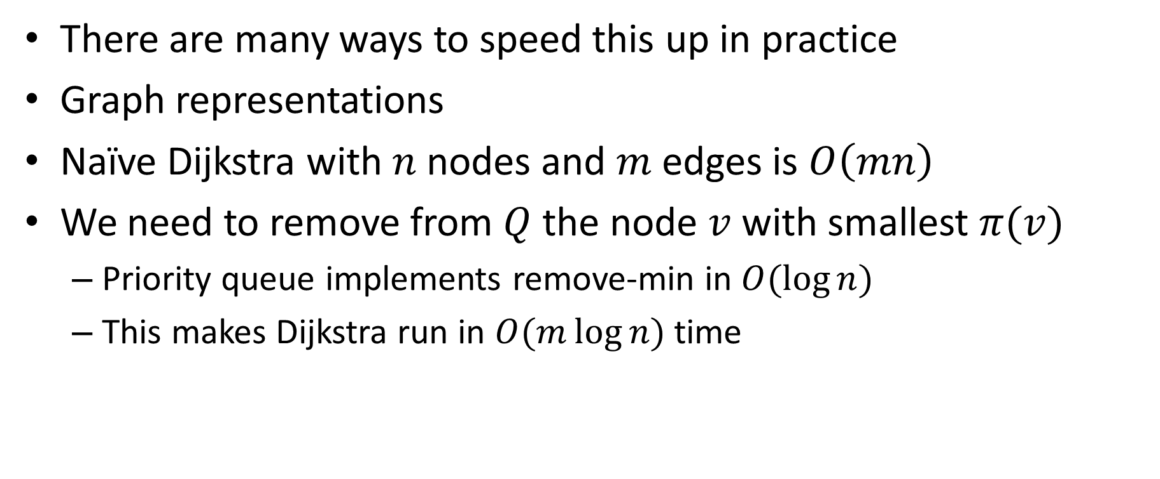
Implementation notes
There are many ways to speed this up in practice
Graph representations
Naïve Dijkstra with $n$ nodes and $m$ edges is $O\left(mn\right)$
We need to remove from $Q$ the node $v$ with smallest $π(v)$
Priority queue implements remove-min in $O(\log{n)}$
This makes Dijkstra run in $O(m\log{n)}$ time

Slide 49
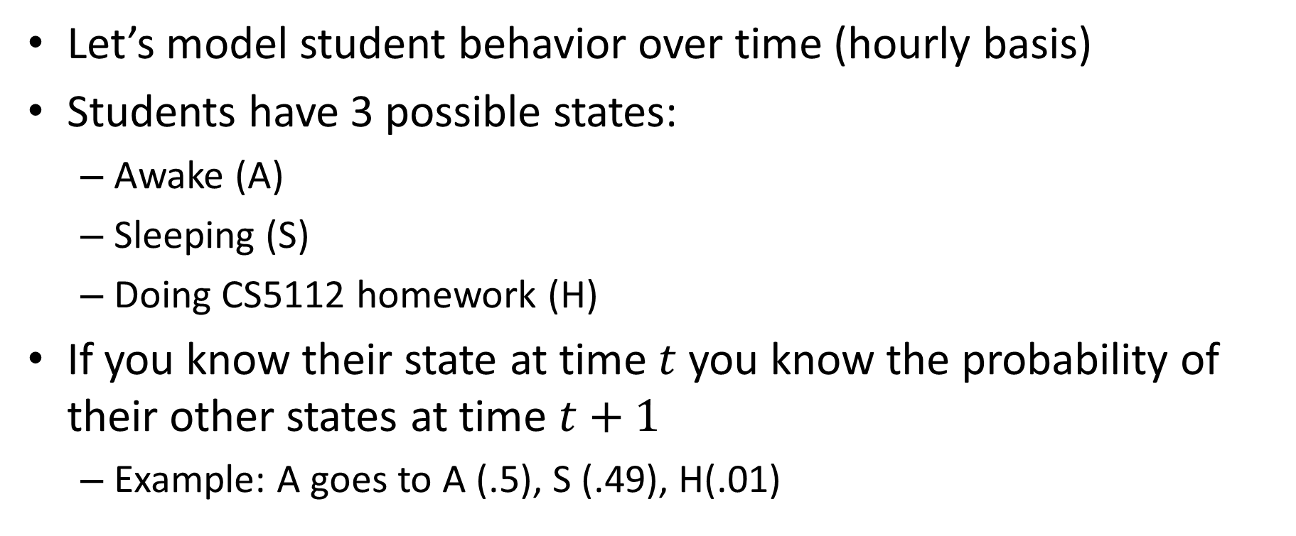
Another class of examples
Let’s model student behavior over time (hourly basis)
Students have 3 possible states:
Awake (A)
Sleeping (S)
Doing CS5112 homework (H)
If you know their state at time $t$ you know the probability of their other states at time $t+1$
Example: A goes to A (.5), S (.49), H(.01)

Slide 50
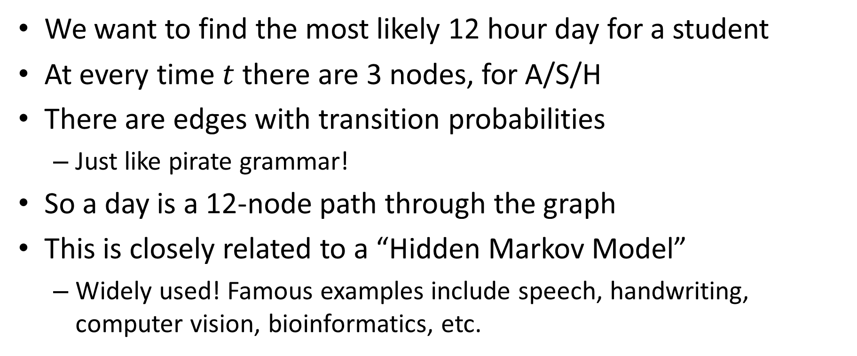
Trellis graph
We want to find the most likely 12 hour day for a student
At every time $t$ there are 3 nodes, for A/S/H
There are edges with transition probabilities
Just like pirate grammar!
So a day is a 12-node path through the graph
This is closely related to a “Hidden Markov Model”
Widely used! Famous examples include speech, handwriting, computer vision, bioinformatics, etc.

Slide 51



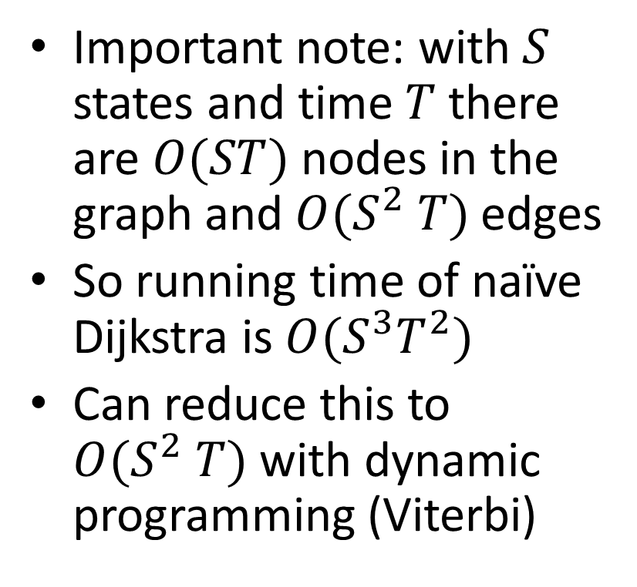



Example
Important note: with $S$ states and time $T$ there are $O(ST)$ nodes in the graph and$O(S^{2} T)$edges
So running time of naïve Dijkstra is $O(S^{3}T^{2})$
Can reduce this to $O(S^{2} T)$with dynamic programming (Viterbi)
$$A$$
.5
$$A$$
$$A$$
.49
$$S$$
.01
$$S$$
$$S$$
$$H$$
$$H$$
$$H$$
$$t=1 t=2 t=3$$

